Slide 1

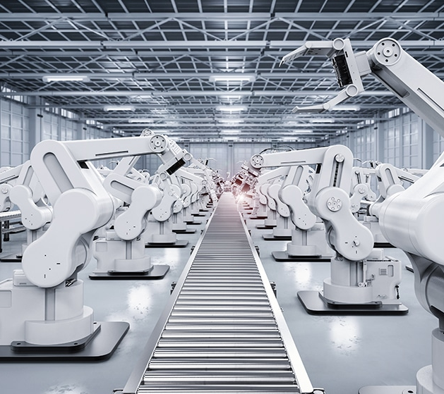
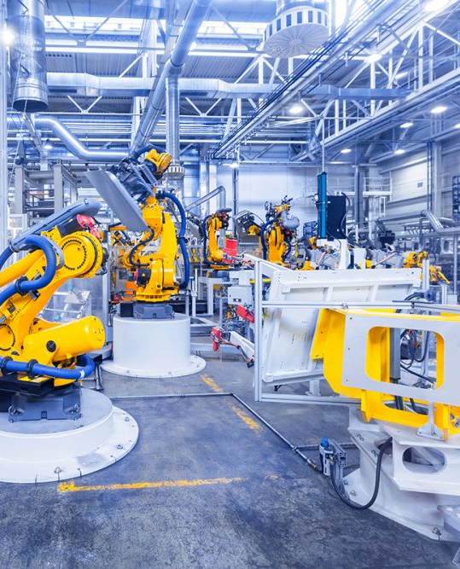
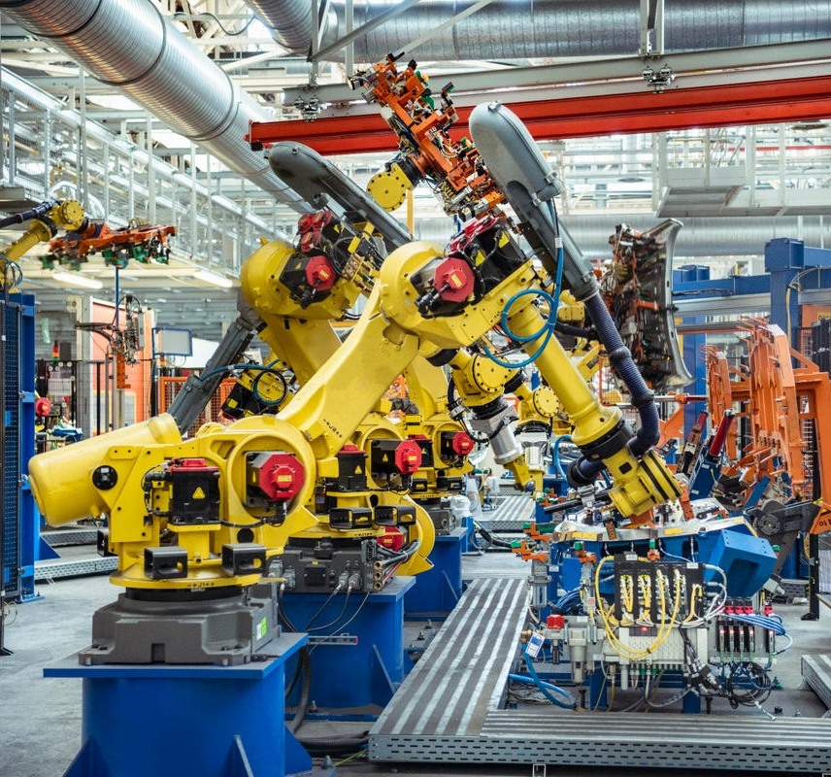
The Future of employment, jobs, and work through automation (Industrial Robots)
Liam Kennedy 21143508
Daniil Volodin 21145753
Casey Etoka 21141402

Slide 2
Justification of the topic + importance and the opportunities for society
Industrial robot is a robotic arm that is automated to perform specific tasks that are hard, dangerous, or too monotonous for humans. The arm consists of manipulator used in movement and rotation, controller regulates robot activity, and an end-effector is a device that interacts with a given task.
Robots help increase productivity in the workplace. According to the information on International Trade Administration's website, adopting industrial robots has led to growth in productivity. Among all industries, a one percent increase in quantity correlated with an increase in productivity of 0.8 percent.
Industrial Robots also provide efficiency while simultaneously lowering the production costs. BCG (Boston Consulting Group), an American global management consulting firm analysis found that using advanced robots can reduce conversion costs by up to 15%, and combining advanced robotics with other technologies, process enhancements, and structural layout changes can yield savings of up to 40%.

Slide 3
Risks posed and choices
As the number of industrial robot installations grow, the employment rate in industries with easily automated labour will likely begin to decline. The tasks are performed much quicker and more precisely by robots than human workers. In the article "Robots and Jobs: Evidence from U.S. Labour Markets", published by MIT professor Daron Acemoglu, the researchers found that for every robot added per 1,000 workers in the U.S., wages decline by 0.42% and the employment-to-population ratio goes down by 0.2 percentage points — to date, this means the loss of about 400,000 jobs. Between 1990 and 2007, the increase in robots (about one per thousand workers) reduced the average employment-to-population ratio in a zone by 0.39 percentage points, and average wages by 0.77%, compared to commuting zones with no exposure to robots. This implies that adding one robot to an area reduces employment in that area by about six workers.

Slide 4
Team Allocation
The purpose of our investigation was to address opportunities and risks concerning the future of employment, work and jobs, and how it's going to be affected by industrial robots. Throughout the project development, team members have contributed in the following ways:
Daniil- Responsible for finding relevant information from well-founded sources regarding the topic/tech. The information has been referenced in the APA format (name, date, title and URL). Second responsibility was checking up and editing on the team project, trying to make it brief and clear.
Liam- Responsible for conceptual design of project (outlining the general idea of the presentation). Second responsibility was aesthetic design of project. (layout and theme of design)
Casey- Responsible for managing time and ensuring all tasks are complete before the allocate time. Second responsibility is checking in and making sure we are all doing what we are supposed to be doing.
Reference List
Opportunities (research on the productivity of industrial robots)
Daniel Küpper, Markus Lorenz, Claudio Knizek, Kristian Kuhlmann, Andreas Maue, Ralph Lässig, and Tilman Buchner. (2019, March 27). "Advanced Robotics in the Factory of the Future". BCG. https://www.bcg.com/publications/2019/advanced-robotics-factory-future/
Opportunities (research on cost efficiency of industrial robots)
Kara Mazachek. (2020, December 22). "Robots and the Economy: The Role of Automation in Productivity Growth". https://blog.trade.gov/2020/12/22/robots-and-the-economy-the-role-of-automation-in-productivity-growth/
Risks and Choices (research on the impact of industrial robots on employment)
Sara Brown (2020, July 29). "A new study measures the actual impact of robots on jobs. It’s significant.". https://mitsloan.mit.edu/ideas-made-to-matter/a-new-study-measures-actual-impact-robots-jobs-its-significant/

